Slide 1
DATABASE MANAGEMENT SYSTEMS PROJECT
Life Insurance
Database Management System
Designed & Implemented using MySQL 9.6
BY NYANGOMA CHRISTINE
2025/BCS/152/PS
DB
5 Tables
3 Customers
3 Policies
3 Agents

Slide 2
PROJECT INTRODUCTION
DEFINITION
SCOPE
The life insurance database management system is a software designed to manage policyholders, insurance policies, premium payments, claims, and agents efficiently.
Customer Management
The system replaces manual record keeping with a structured MySQL based database , improving:
Data accuracy
Retrieval speed
Decision making
Policy Tracking
.
Agent Records
Payment Logging
The system operates in the insurance Industry, specifically life insurance
The main users of the system include; customers, insurance agents and company administrators.
OBJECTIVE
To design and implement a relational database system to manage life insurance operations including customers, policies, agents, payments, and claims.
Claims Processing

Slide 3
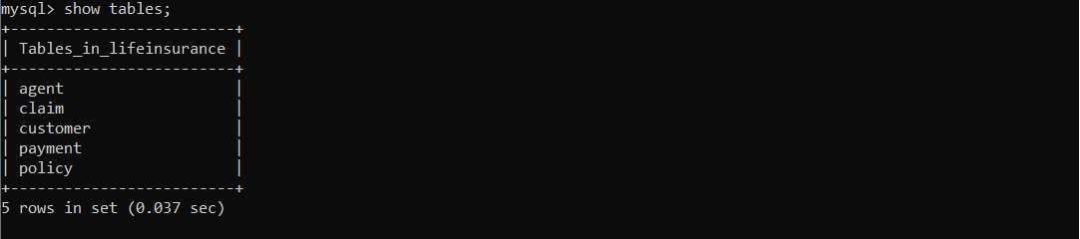
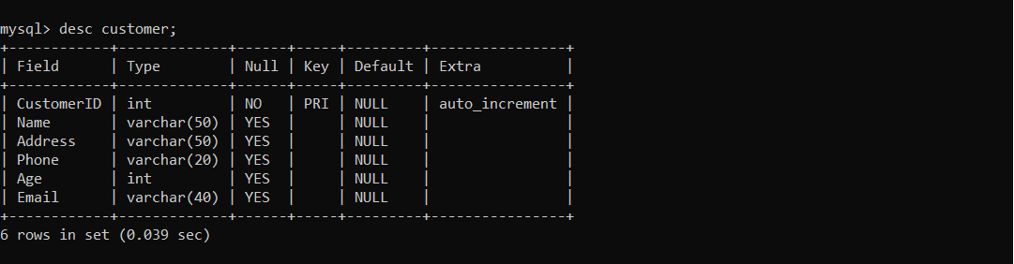
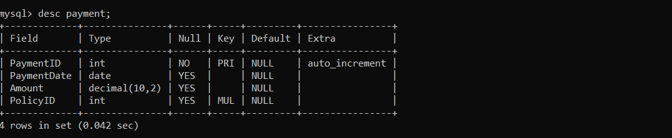
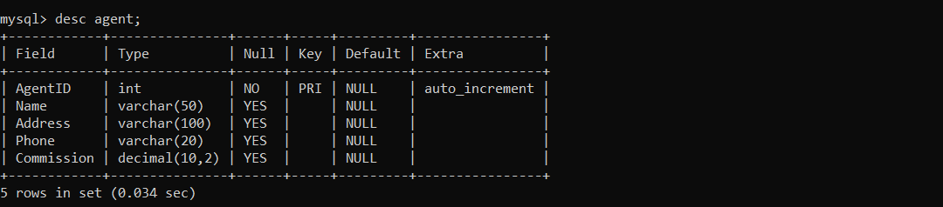
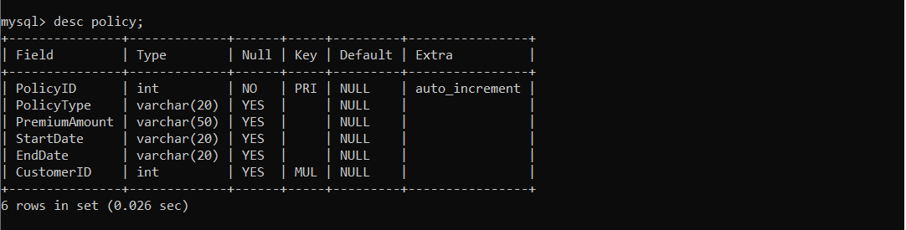
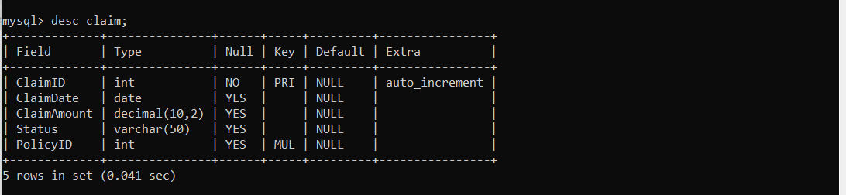
DATABASE TABLES
CUSTOMER
POLICY
CLAIM

Slide 4
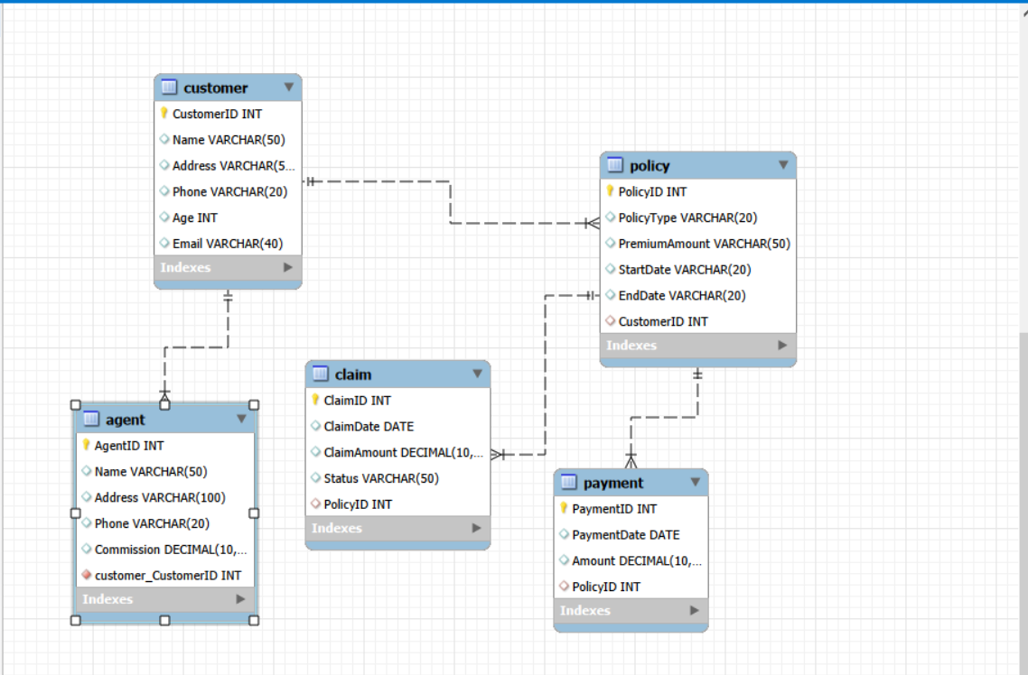
TABLE RELATIONSHIPS & ERD

Slide 5
SAMPLE DATA — SELECT * Results
SELECT * FROM customer;
ID | Name | Address | Phone | Age | Email
1 | NANZIL SHAMIRAH | NTUNGAMO | 0790-456-239 | 19 | nanzilshamirah@gmail.com
2 | NYANGOMA CHRISTINE | MBARARA | 0771-798-106 | 20 | cnyangoma01@gmail.com
3 | KATO CRESCENT | MBARARA | 0778-734-128 | 20 | katocrescent@gmail.com
SELECT * FROM policy;
PolicyID | Type | Premium | StartDate | EndDate | CustID
10 | life | 500.00 | 2026-06-01 | 2030-06-01 | 1
11 | Life | 400.0 | 2026-06-02 | 2030-06-02 | 2
13 | Life | 800.0 | 2026-06-03 | 2030-06-02 | 3
SELECT * FROM agent;
AgentID | Name | Address | Phone | Commission
1 | AMUMPAIRE SHARON | BUSHENYI | 0708-689-453 | 600.00
2 | ARIHO IVAN | MBARARA | 0789-281-347 | 500.00
3 | ARIKIRIZA MIDRED | IBANDA | 0774-560-450 | 700.00

Slide 6
KEY SQL QUERIES
01
Show all databases
02
List tables in the database
SHOW DATABASES;
USE lifeinsurance;
SHOW TABLES;
Lists all databases on the server, confirming the lifeinsurance DB exists.
Switches context to the database and lists all 5 tables.
03
Describe table structure
04
Retrieve all customer records
DESC customer;
DESC policy;
SELECT * FROM customer;
Displays column definitions, data types, keys, and constraints for each table.
Returns all rows from the customer table showing ID, name, address, phone, age, and email.
05
Retrieve all policy records
06
Retrieve all agent records
SELECT * FROM policy;
SELECT * FROM agent;
Fetches all policies with their types, premium amounts, dates, and linked customer IDs.
Returns agent details including name, address, phone, and commission earned.

Slide 7
THANK YOU !!
NYANGOMA CHRISTINE
2025/BCS/152/PS
PRESENTING TO YOU
LIFE INSURANCE DATABASE MANAGEMENT PROJECT

